Slide 1
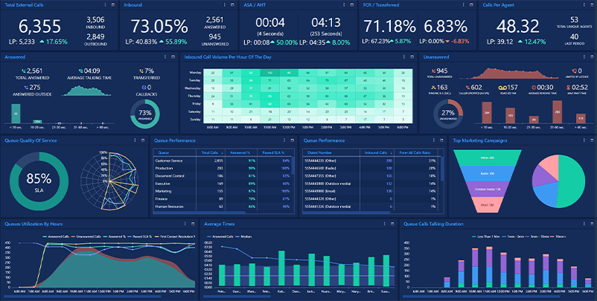

CallCenterSoftware.co.in
CallCenterSoftware.co.in
Mobile Auto Dialer system for telecaller supported by powerful cloud based Bonrix CRM

Slide 2


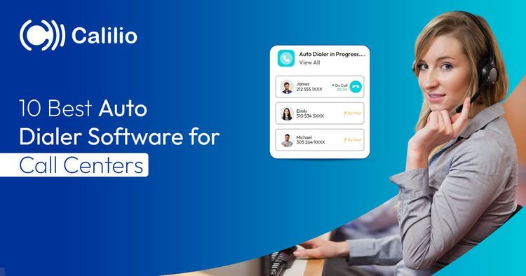



About Us
CallCenterSoftware.co.in offers an advanced Mobile Auto Dialer system supported by Bonrix CRM for efficient lead management.
Seamless batch allocation
Efficient telecaller dialing
Easy import/export of lead data (XLSX, XLS, CSV)
Optimizing telecalling operations
Ahmedabad, Gujarat, India

Slide 3





Our Products
Standalone Auto Dialer
Multi Column Mobile Dialer
Designed for telecallers to reach many customers efficiently using Android handsets with 3G/4G/5G GSM SIM.
For outbound call centers processing leads via SIM-based Android devices, tablets, or desktop phones.
One-by-one customer calling
Computer Telephony Integration
Lead Management System
NDNC/DND Filtering
Comprehensive solution for managing leads, tracking progress, and optimizing conversion rates.
Web application to scrub and filter DND numbers from calling lists, ensuring compliance.
Admin and staff access levels
Compliance with regulations

Slide 4
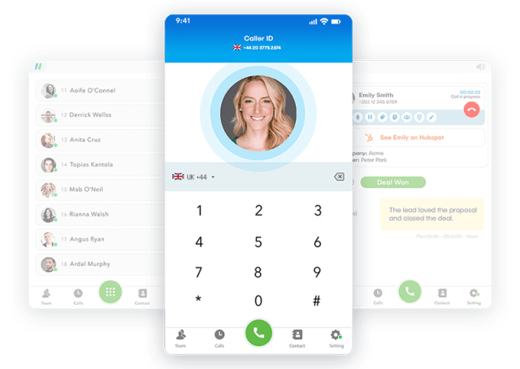





Bonrix Standalone Auto Dialer App
Designed for Telecaller in call centers who want to reach many customers in a day. This app has a facility for calling the number of customers one by one from Android Handset using 3G/4G/5G GSM SIM.
Mobile-First Solution
Works directly on Android handsets with SIM cards
Increased Efficiency
Reach more customers in less time
Network Compatibility
Supports 3G/4G/5G GSM networks
Sequential Calling
Calls customers one by one from your list
Version 1.3 Available

Slide 5
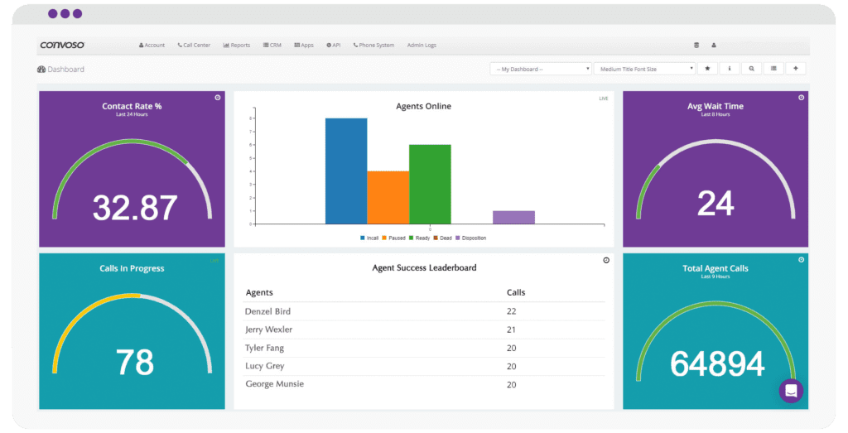




Bonrix Multi Column Mobile Auto Dialer
This Android app is developed for outbound call centers for processing leads via normal SIM card-based Android mobile handsets, tablets, or desktop-based phones working either on GSM, 3G, CDMA, or PSTN landline technology.
Multi-Device Support
Works on mobile handsets, tablets, and desktop phones
CTI Integration
Computer Telephony Integration for lead processing
Network Flexibility
Supports GSM, 3G, CDMA, and PSTN technologies
Multi-Column Interface
Efficient lead management with organized columns
Version 1.0 Available

Slide 6

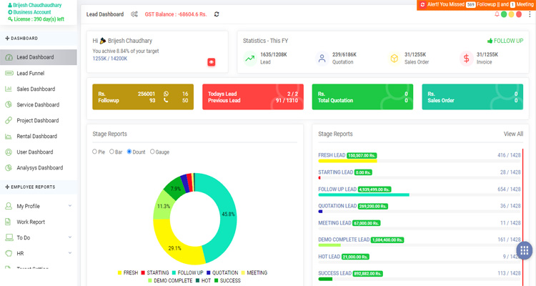



Bonrix Lead Management System (LMS)
A comprehensive system for managing leads efficiently with different access levels for admin and staff.
Role-Based Access
Different permission levels for admin and staff users
Lead Tracking
Monitor lead status and conversion progress
Data Management
Import/export leads in multiple formats
Analytics Dashboard
Visual reports on lead performance metrics
Demo Credentials
Admin:
username: admin, password: admin123
Staff:
username: staff, password: staff321

Slide 7
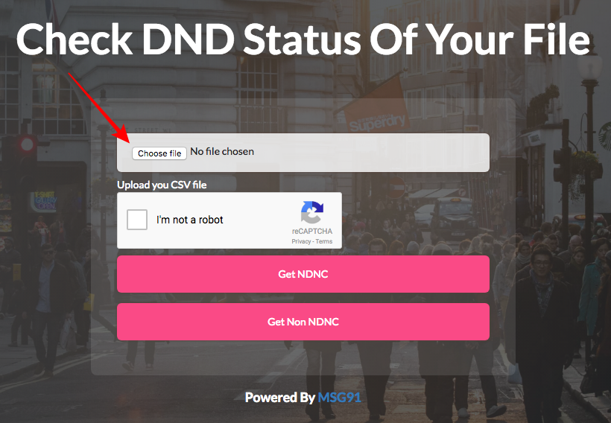




Bonrix NDNC/DND Scrubbing/Filtering Web Application
A web application to filter and scrub DND (Do Not Disturb) numbers from calling lists, ensuring compliance with regulations.
Number Filtering
Automatically identifies and removes DND numbers
Regulatory Compliance
Ensures adherence to NDNC/DND regulations
File Upload
Supports CSV file uploads for batch processing
Risk Reduction
Minimizes legal risks and penalties
Demo Credentials
Demo:
username: demo, password: demo123

Slide 8








Key Features
Our comprehensive call center solutions offer these powerful features to optimize your telecalling operations
Cloud-based CRM
Mobile Auto Dialing
Lead Management
Batch Allocation
Seamless integration with powerful cloud CRM system
Efficient one-by-one customer calling from mobile devices
Comprehensive tracking and management of leads
Systematic distribution of leads among telecallers
Data Import/Export
DND/NDNC Filtering
Multi-Device Support
User-Friendly Interface
Support for XLSX, XLS, and CSV file formats
Ensure compliance with regulatory requirements
Works on Android, tablets, and desktop systems
Intuitive design for easy adoption and use

Slide 9





Contact Us
Address A-801, Samudra Complex, Near Klassic Gold Hotel, Off C.G.Road, Ahmedabad, Gujarat, India
Email info@bonrix.net
Phone +91-9426045500, 9429045500
Ahmedabad, Gujarat, India
Website https://callcentersoftware.co.in/
Thank You!

